Slide 1
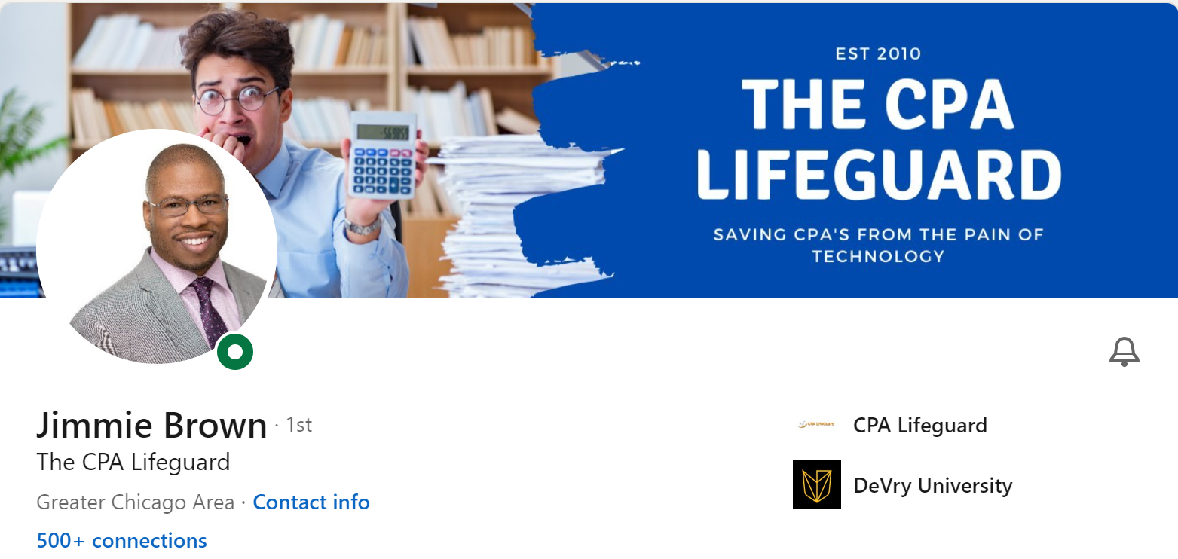
DISTRICT 30
Jimmie Brown, President SWM
TOASTMASTERS LEADERSHIP INSTITUTE

Slide 2
win with Toastmasters - through Speechcraft
Jimmie Brown Representing Saturday Morning Workout

Slide 3
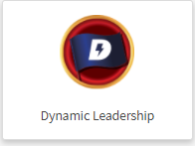
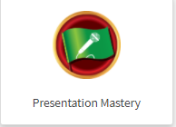
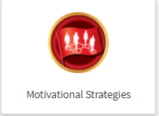
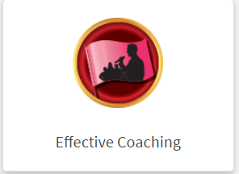
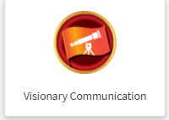
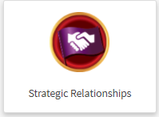
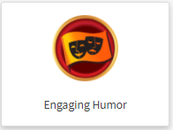
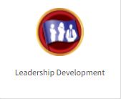
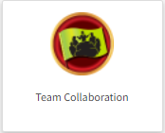
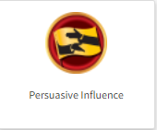
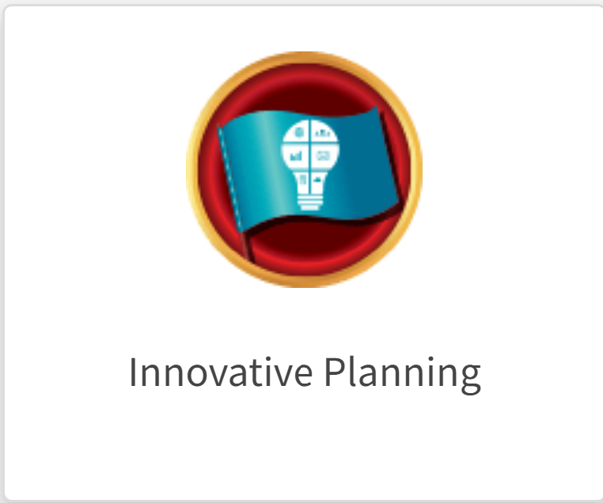
ABOUT ME
Toastmaster since May 2018
EDUCATIONAL LEVEL – Twice distinguished Toastmaster (DTM)
Paths completed -
Paths underway -
Served as the Club Coach, President, pathways mentor, VP PR and VP Membership
Active MEMBER OF 8 CLUBS in 4 districts & coordinator/advisor on 5 speechcrafts!
Member of these Clubs in D30 : Saturday Morning Workout(8294), Kavi Toastmasters (2900788) & Long grove / lake Zurich Toastmasters(169)
D103 International Speech Contest District champion (2020)
Placed 3rd at the District level D30 International Speech Contest in 2019 & Placed 2nd at the district level Evaluation speech content in 2021

Slide 4
Representing Saturday morning workout today
Chartered on Jun 1st, 1991
Meets every 1st 3rd and 5th Saturday from 8-10 am via zoom
We are a community club!
Consistently has had a membership base between 45-48 members (The Club with most members in the D30!)
Why are we unique?
President’s distinguished club 15 years in a row!
Every member gets a mentor! Director of mentorship is an elected position in the club!
We try to do at least one speechcraft a year – This is a fantastic membership building & retention tool!
Every meeting has a Thanks to Toastmasters – members get to share what toastmasters has done for them thus inspiring other members & guests!
We are a friendly & welcoming group, and we are the Saturday morning workout family!
When other clubs dwindled and the numbers fell, Saturday morning workout continued to grow
Contests challenge us & help us grow so we compete!
This is your practice field – your very own laboratory!
Committed officers & Executive advisors' group!
Well connected via WhatsApp – Our group has 65-70 members!

Slide 5
My focus today will be on SPEECH CRAFT

Slide 6
What is a speechcraft?
A Workshop Program by toastmasters international designed to develop your public speaking ability and presentation skills

Slide 7
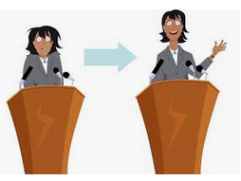
WHO CAN BENEFIT FROM A speechcraft?
New members who want to get their feet wet and dive into Pathways & public speaking
Prospective members who would like to participate in a structured public speaking program prior to joining Toastmasters

Slide 8
HOW is THE speechcraft STRUCTURED?

Slide 9
Speechcraft session #1
Introduction exercise
Distribution of Manuals
Two Educational Sessions
Selecting a speech Topic
How to give An Icebreaker Speech
Assignment of Advisors
Table Topics
Evaluations by Advisors

Slide 10
Speechcraft session #2
Icebreaker Speeches by Speechcrafters
Two Educational Sessions –
Introducing a Speaker
Speech Organization
Evaluations by Advisors

Slide 11
Speechcraft session #3
‘Organize your Speech’ Speeches by Speechcrafters
Two Educational Sessions –
Speech with a Purpose
Body Language & Vocal Variety
Table Topics
Evaluations by Advisors

Slide 12
Speechcraft session #4
‘Get to the Point’ Speeches by Speechcrafters
One Educational Session –
Giving Great Evaluation
Invite a guest speaker
Evaluations by Speechcrafters
Program culminates in a graduation!

Slide 13
logistics
Cost of the Speechcraft Digital Bundle ( for 5 members ) - $50
4 session Speechcraft Program – mm/dd/yy – mm/dd/yy
Coordinator of the Program – name(s)
Advisors – Need TM Advisors or Mentors who can be paired up with the new members
PR & Recruitment : create the Flier & the vp pr will need to publicize it
Enrollment Period : before mm/dd/yy

Slide 14
Sample speechcraft brochure

Slide 15
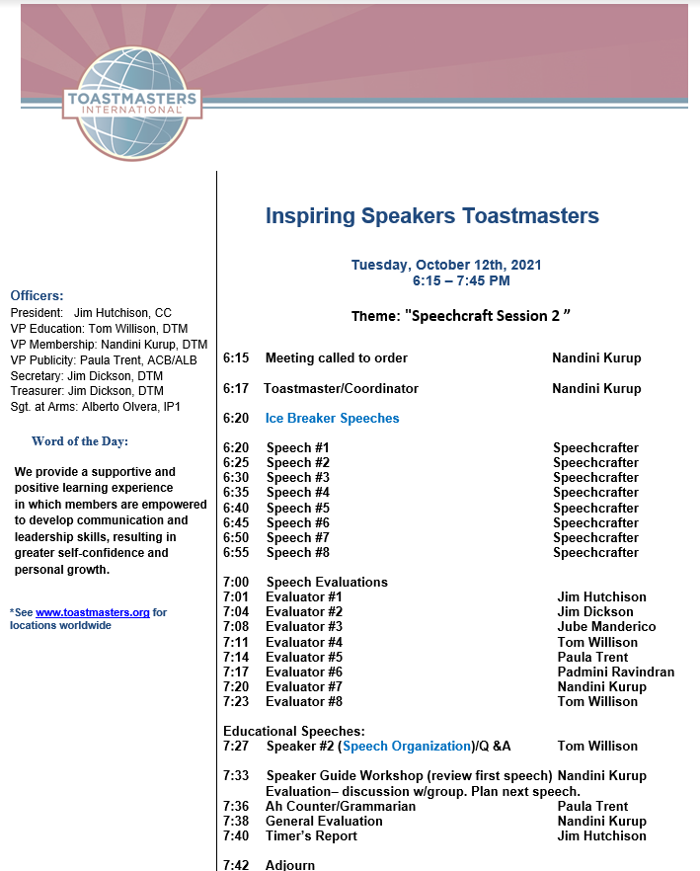
Sample speechcraft session agenda

Slide 16
TIMELINE & journey
Introduction to roles, evaluation & selecting a speech topic
Organize a speech, give evaluations & speech purpose & master Table Topics
Get to the point speeches, bring it all together & Graduation
Icebreakers, Introduction to Speech evaluations & speech organization
Speech #3
Speech #2
SESSION-4
Speech #1
SESSION-3
SESSION-2
SESSION-1
ATTEND REGULAR MEETING
CONTINUE YOUR TM JOURNEY

Slide 17
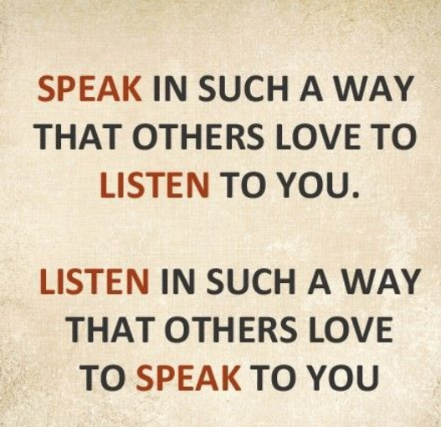

Slide 18
Questions?
You can reach me @
brown.jimmie@gmail.com

Slide 19
THANK YOU!!

