Slide 2
Member Personas
Jerry Evans, DTM

Slide 3
Customer loyalty is what you get
when you create a motivating
Environment for your people.

Slide 7
Member Personas
Six distinct member personas were clearly identified from the analysis. Each persona has a unique background, set of personal characteristics and goals.
The Young Professional
The Self-Help Enthusiast
The Career Advancer
The Retiree
The Mature Manager
The International Professional

Slide 8
Understanding Persona and Characteristics
The Student
The Early Career Enthusiast
The Striving Associates
The Social Professional
The Confident Leader
The Successful Leader
The Retiree

Slide 9
Understanding the Member Personas
The Student
The Early Career Enthusiast
The Striving Associate
The Social Professional
The Confident Leader
The Successful Leader
The Retiree

Slide 16
Tools and Resources

Slide 17
What tools and resources have you used or seen used that were effective?

Slide 18
Tools and Resources -Toastmasters Magazine Articles Online
Be our Guest
Spread the Word
Social Media Tips for Your Club
Give Members and Guest a Compelling CX
3 Social Media Platforms Every Club Needs.

Slide 19
Other Resources
Toastmasters Media Center
Club Marketing Guide
Find a Club Best Practices
Let the World Know
Social Media Workshop (Video)

Slide 20
You never get a second chance to make a first impression.
10

Slide 21
What is one thing you learned from this session that you will implement in your club?

Slide 22
Session Assessment
Go to link in Chat
You have 5 minutes

Slide 23
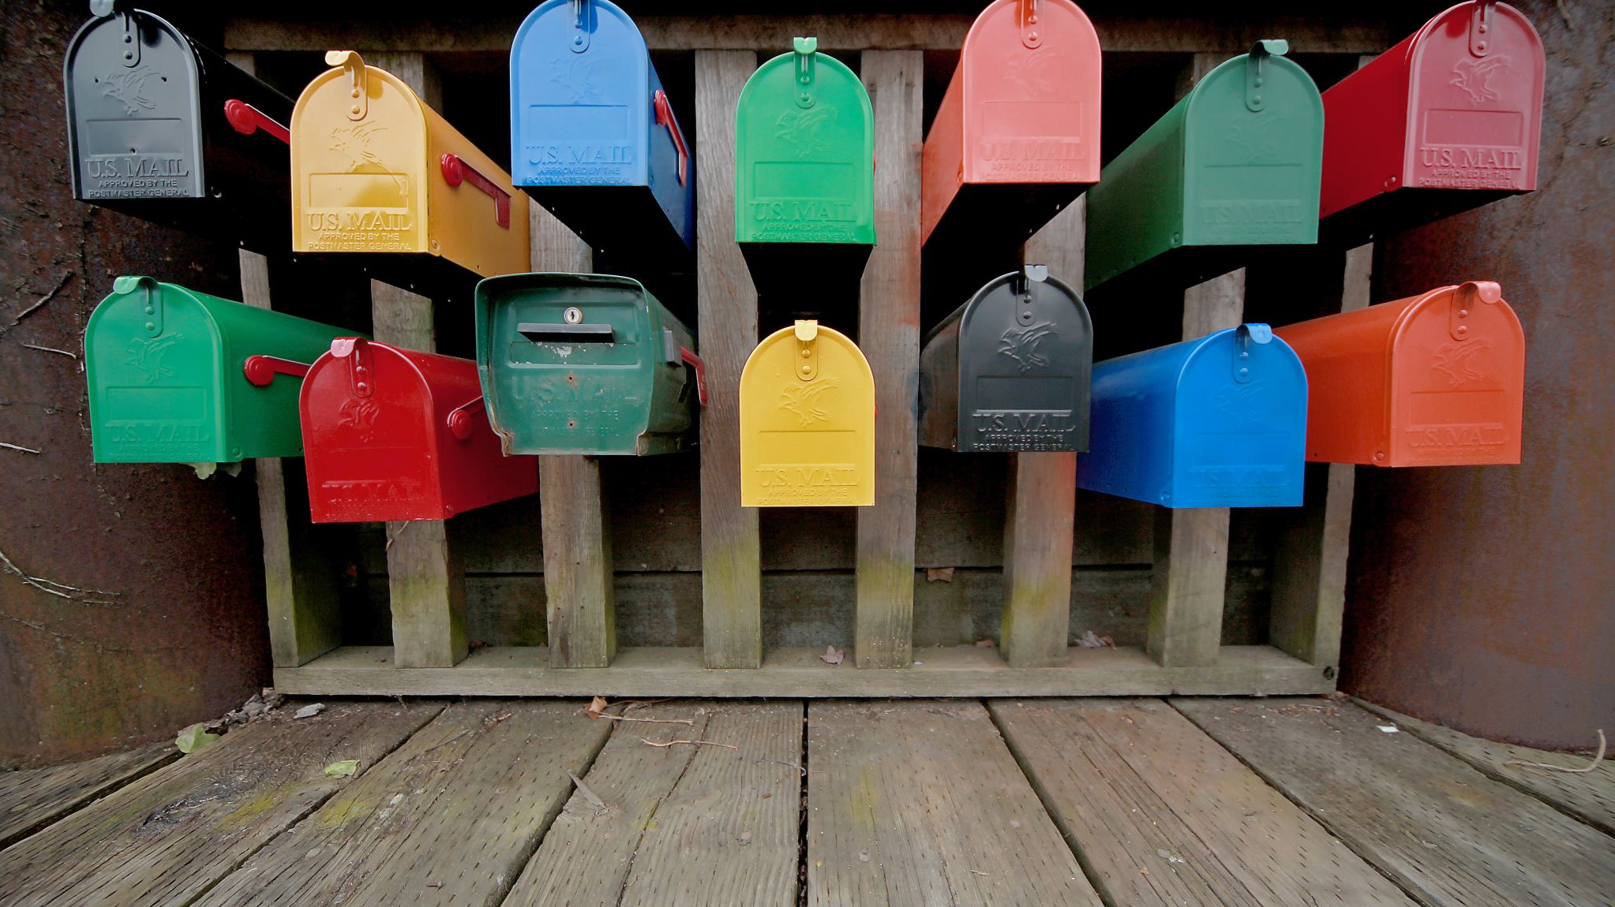
Jerry Evans, DTM
jerry@theawardscompany.com
630-640-6219

