Slide 1


Entrance
You’re attending a Toastmasters TLI and chatting with your fellow Toastmasters…
Suddenly the lights flicker and the room goes dark! You hear a curse, a thud and then silence.
The lights come back on. You look around the room, but the keynote speaker is missing! And the door is locked!!!
Can you solve the clues to escape the room and find out why the keynote speaker has disappeared?
Welcome to Toastmasters!

Slide 2
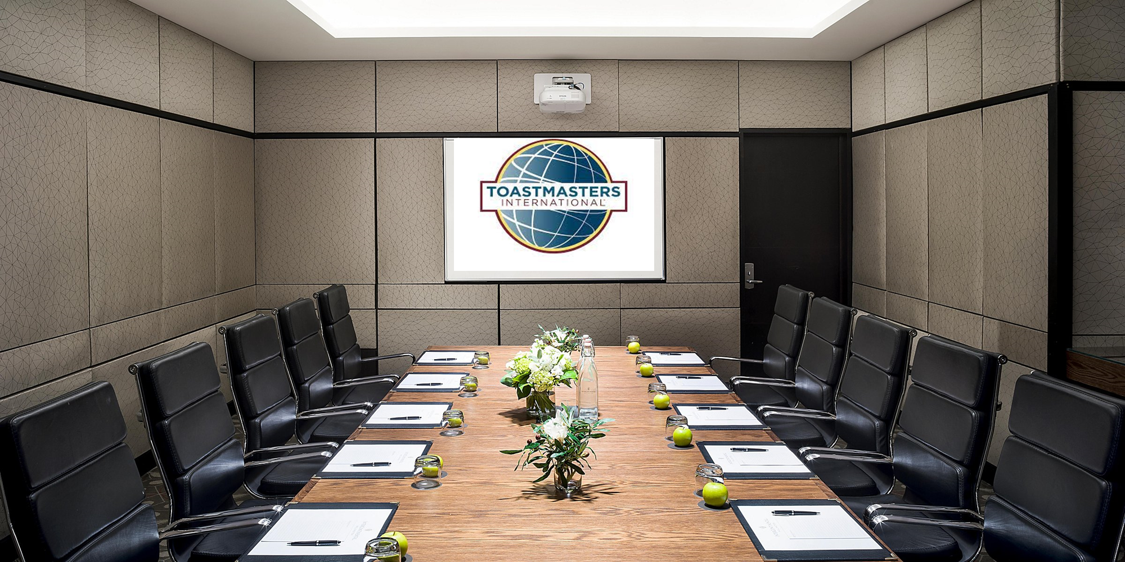
The Room
You are in a conference room and notice various items.
Presentation
Flowers
Water Bottles
Glasses
Chairs
Apples
Notepads
Walls
There is one door with a 4-combo push button lock.
Can you make it out of the room?

Slide 3
Walls
These seem like standard conference walls. They are gray with a black pattern. It looks like a garden path.
Should you examine the walls further?
Yes, Examine the walls!
No, Return to the room

Slide 4
Walls Examined
You see a small note that reads…”I give you the opportunity to build up to 300 unique competencies with online content you can learn anytime anywhere. I give you real-world, transferable skills.
What am I and how many of me do you get when you join Toastmasters?
Return to the room

Slide 5
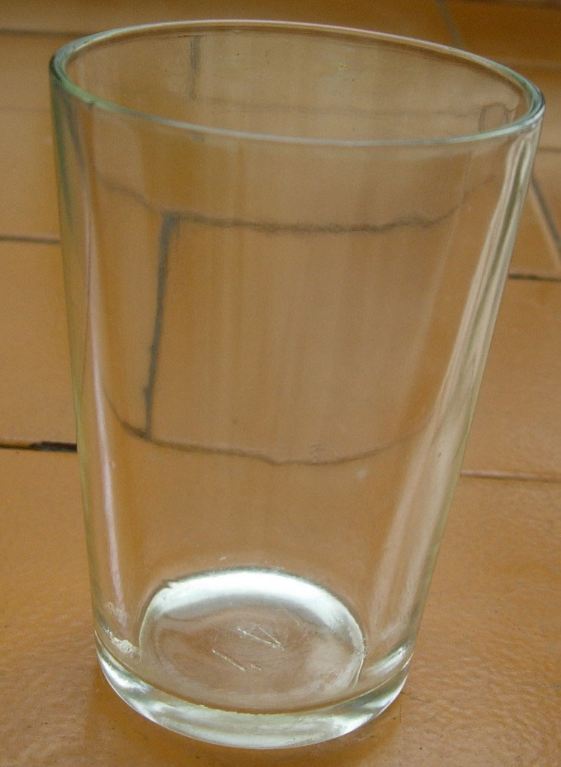
Glasses
There are 10 glasses sitting on the table. You see something yellow under one of the glasses.
Should you examine the glass further?
Yes, Examine the glass!
No, Return to the room

Slide 6
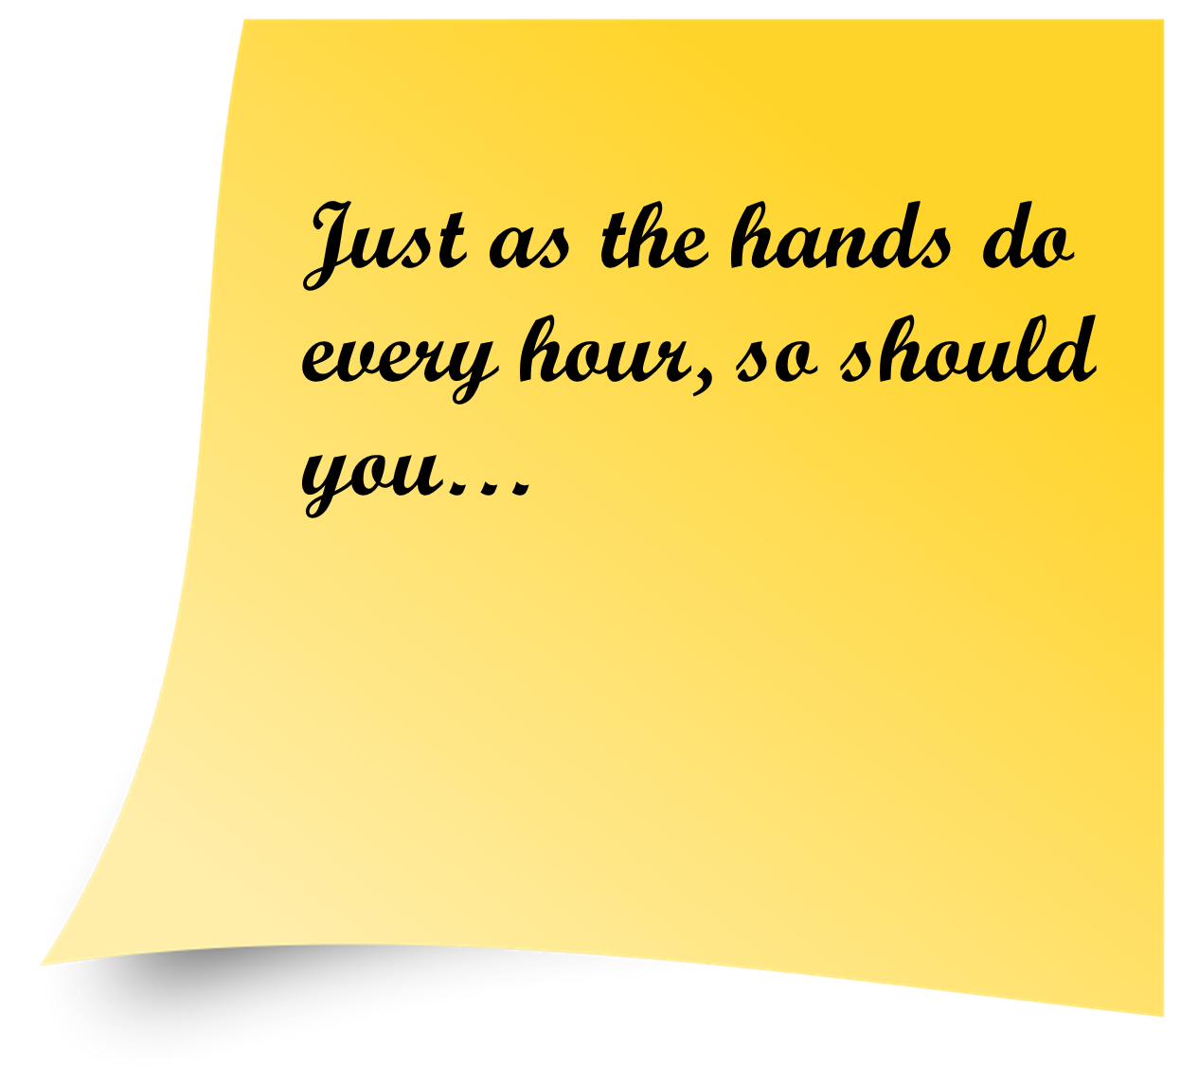
Sticky Note
You see a yellow sticky note stuck to the bottom of one of the glasses. It reads a mysterious message…
“Just as the hands do every hour, so should you…”
What could that possibly mean?!
Return to the room

Slide 7
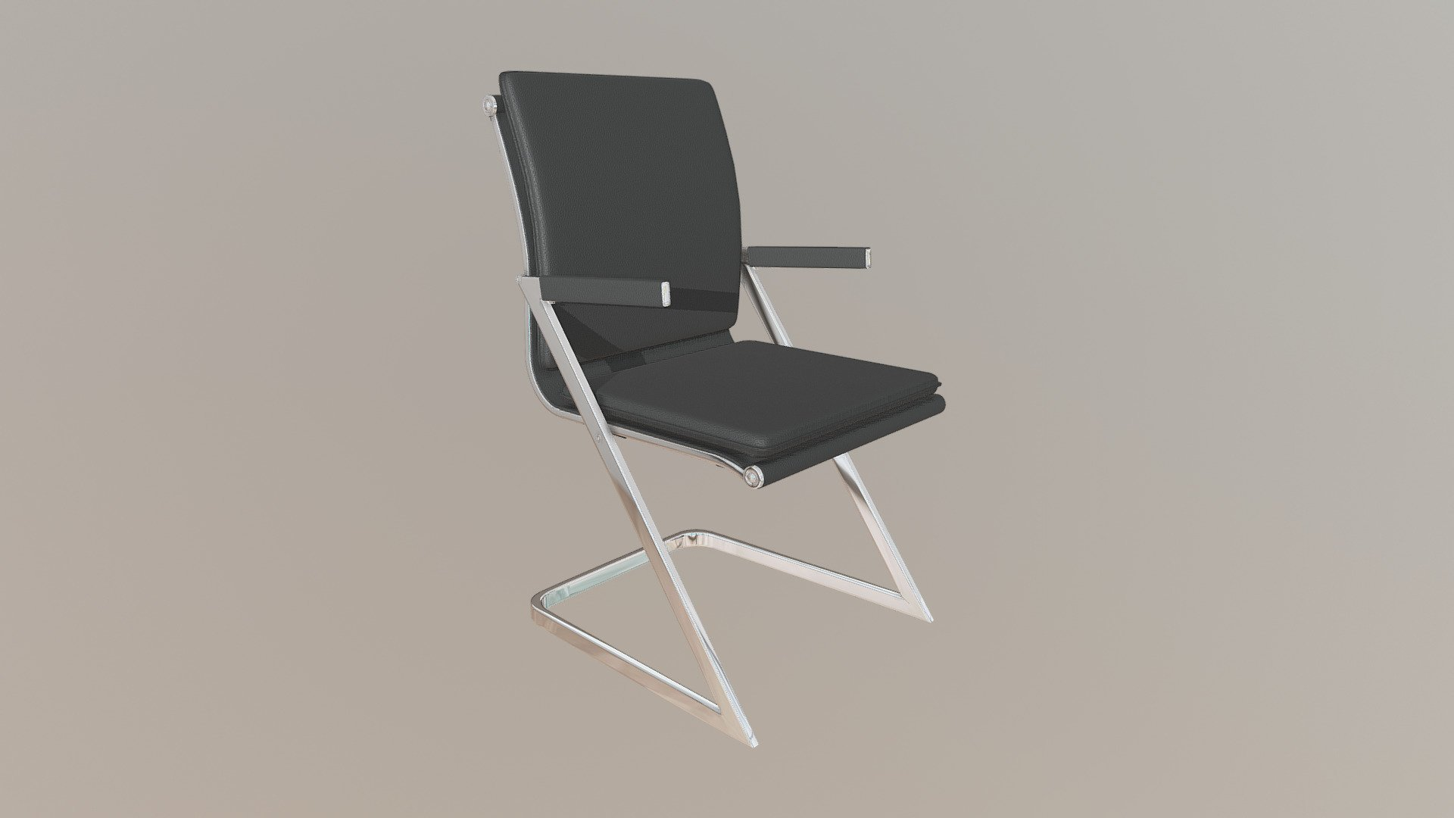
Chairs
There are 10 chairs sitting around the table. At first glance, nothing looks suspicious. Should you examine them further?
Yes, Examine the chairs!
No, Return to the room

Slide 8
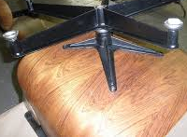
Chairs Examined
You flipped one of the chairs over and there seems to be something written in marker on the bottom.
I have one of the most important leadership roles within Toastmasters International. The success of the district, its clubs and the members within each club depends on how well I execute the responsibilities of my office.
How many main roles am I made of?
Return to the room

Slide 9
Notepads
You notice 10 notepads are sitting on the table. Each with a pen.
Should you examine the notepads further?
Yes, Examine the notepads!
No, Return to the room

Slide 10
Notepads Examined
There appears to be something written on the notepad. “We should grow by at least this amount each year to get DCP credit?”
Return to the room

Slide 11
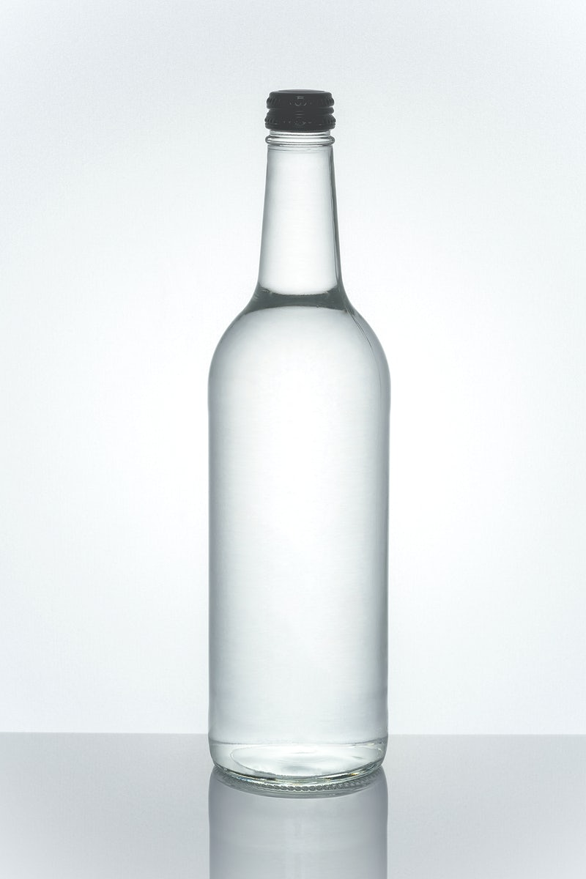
Bottles
There seems to be 3 bottles placed strategically around the table.
Should you examine the bottles closer?
Yes, Examine the water bottles!
No, Return to the room

Slide 12
Bottles Examined
They seem to be filled with some type of liquid…hmmm…it’s tasty water!
Return to the room

Slide 13
Flowers
You notice the flowers on the table. They are different kinds, but you’re no florist, so you can’t name them.
Do you want to examine them further?
Yes, Examine the flowers!
No, Return to the room

Slide 14
Flowers Examined
All they do is make you sneeze. ACHOO!!!
Return to the room

Slide 15
Presentation
You notice there is a presentation already on the screen. It is the Toastmasters logo, but it seems slightly stretched.
Should you examine the presentation further?
Yes, Examine the presentation!
No, Return to the room

Slide 16

Presentation Examined
You pull out your handy Brand Manual and turn to the contents page.
Which pages are about logos?
Return to the room

Slide 17
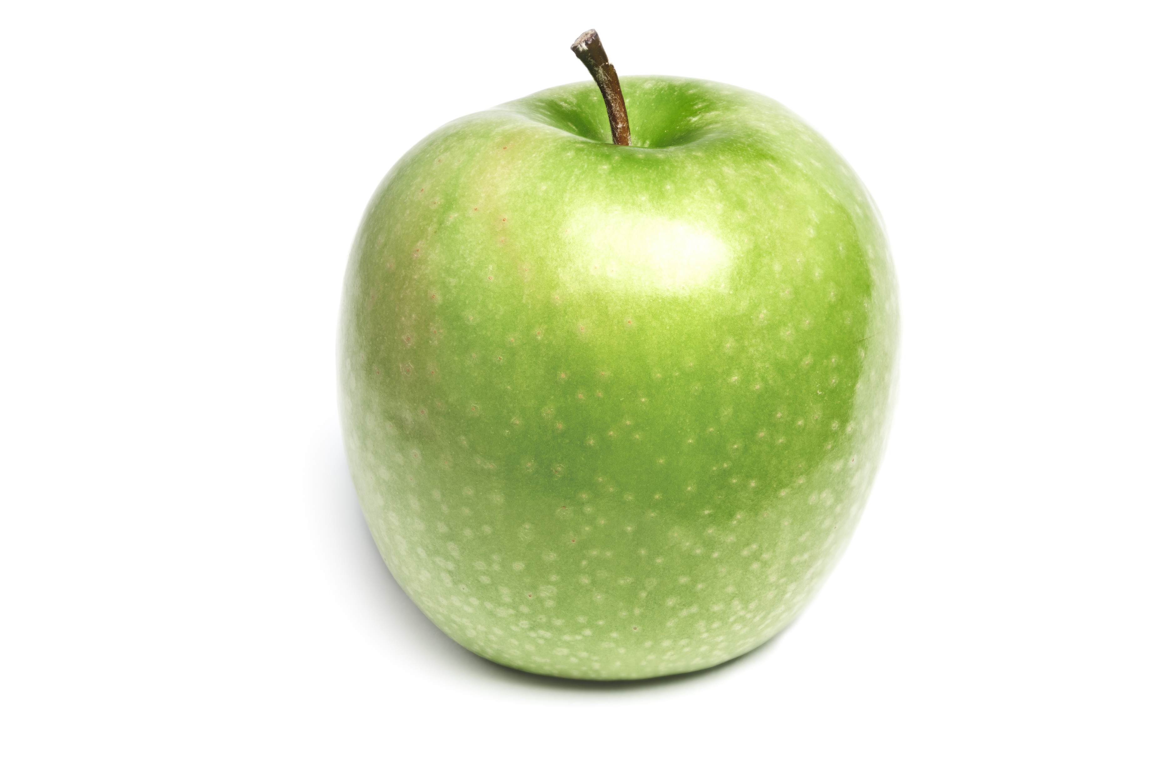
Apples
The apples look sweet and crunchy! Should you examine them further?
Yes, Examine the apples!
No, Return to the room

Slide 18

Apples Examined
These are just ordinary apples. Still, it is a tasty snack.
Return to the room

Slide 19
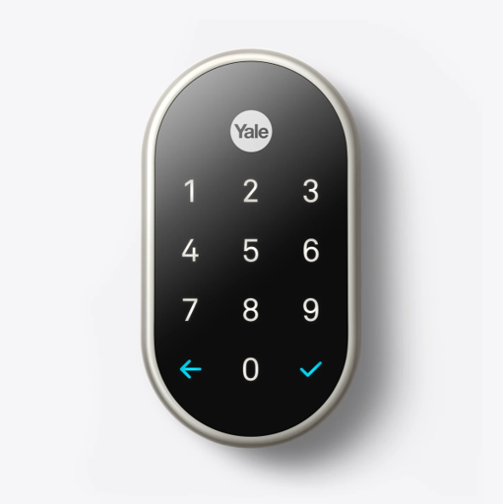
The Lock
You see a numerical push button lock before you. There are digits from 0-9 and a checkmark used as the enter key.

Slide 20
The Lock
You see a numerical push button lock before you. There are digits from 0-9 and a checkmark used as the enter key.

Slide 21
The Lock
You see a numerical push button lock before you. There are digits from 0-9 and a checkmark used as the enter key.

Slide 22
The Lock
You see a numerical push button lock before you. There are digits from 0-9 and a checkmark used as the enter key.

Slide 23
The 1st Button Lock
You hear a confirming beep as you press the button. You’ve got the first number correct.
Do you know the rest?
Yes, I’m ready to enter in the second number!
No, Return to the room

Slide 24
The 2nd Button Lock
You hear a confirming beep as you press the button. You’ve got the second number correct.
Do you know the rest?
Yes, I’m ready to enter in the third number!
No, Return to the room

Slide 25
The 3rd Button Lock
You hear a confirming beep as you press the button. You’ve got the third number correct.
Do you know the rest?
Yes, I’m ready to enter in the fourth number!
No, Return to the room

Slide 26
The 4th Button Lock
You hear a confirming beep as you press the button. You’ve got all 4 buttons correct!
Hit that check mark!

Slide 27

The Lock
The lock turns red as you enter an incorrect number. You will need to return to the room and try again.
Return to the room

Slide 28

You rush through the door, only to find the keynote speaker standing in the hall sheepishly.
When the lights went out, I fell through the door and locked myself out. Wow, you sure know a lot about Toastmasters and its wealth of possibilities! Thanks for coming to get me.

