Slide 1
Secretary Training

Slide 2
Trainer for the session
Kathy Schnur, DTM(Distinguished Toastmaster)
Member Since: April, 2010
Area Governor: 2013-2014
Current member of District 30 clubs:
Toast of UL (Home club)
Speakers of the House
Secret to Success

Slide 3
Agenda:
1. Review of Secretary Responsibilities
2. Questions and Discussion on the Secretary Role

Slide 4
Responsibilities
Secretary responsibilities are listed in the Club Officer Handbook on pages 34-37. This is available online at www.toastmasters.org and search for “Club Officer Handbook”.
Support the Vice-President of Education as base camp manager in Pathways by approving education requests if the VP-Education is unable to do so.

Slide 5
Responsibilities
Discuss the secretary responsibilities for the club with the current secretary and then at the end of the year with the next secretary.
Greet members and guests as they join the virtual/hybrid meeting. Obtained email information from any guests.
Keep the club officer list current in Toastmasters International. The list is updated in Leadership Central in May after the club elections.

Slide 6
How to update club officer list on www.toastmasters.org - Due by May 31st
Log onto www.toastmasters.org
Click on Leadership Central
Click on Club Central
Scroll down until you find “Club Officer Assignment” and click on it.
Using the Drop down arrows, select the member name for each role.
Using the calendar icon, enter the start date and end date.(The toastmaster year is 7/1/xx to 6/30/xx +1 for example: 7/1/22 start date, 6/30/23 end date
Scroll down to the end and click on save.
See screen shots below.

Slide 7
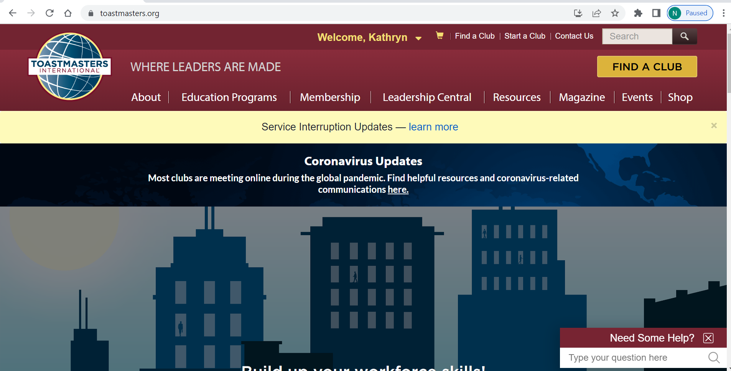

Slide 8
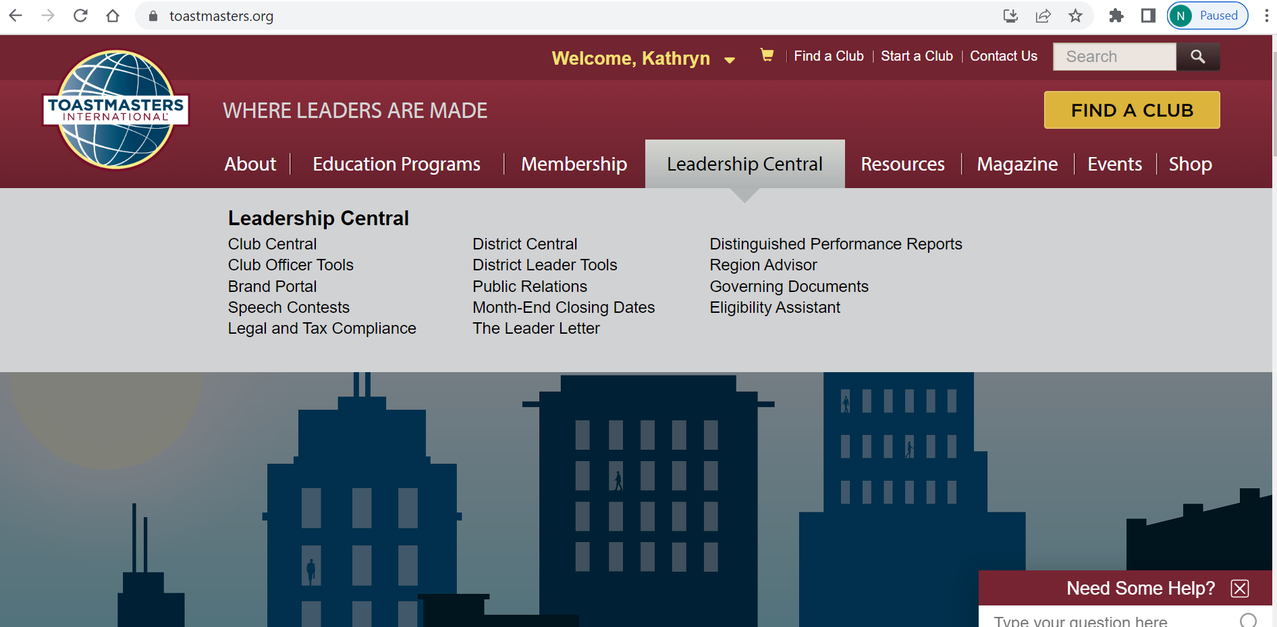

Slide 9
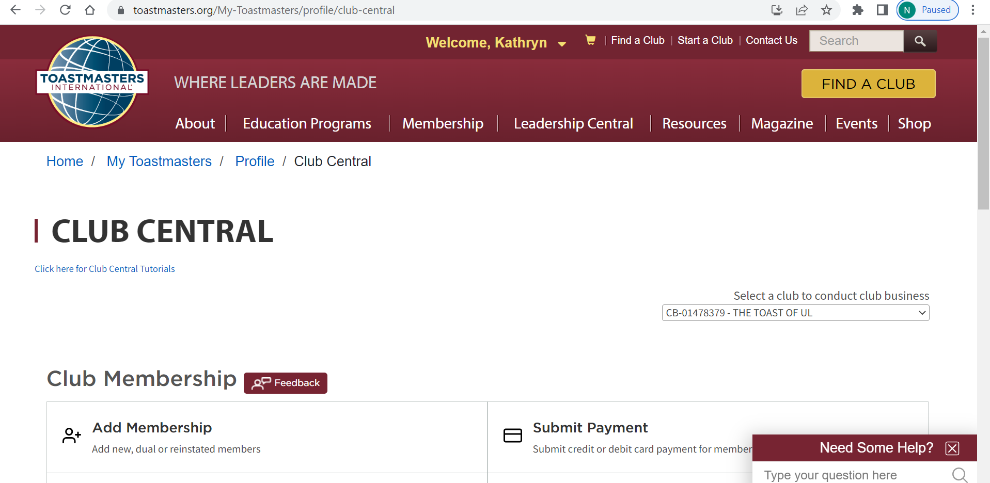

Slide 10
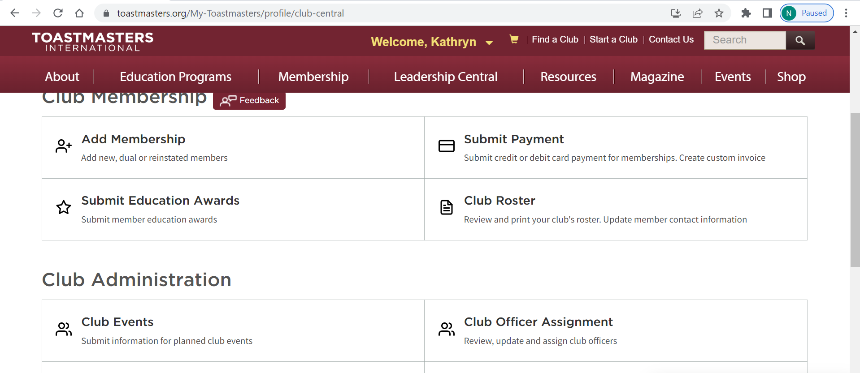

Slide 11
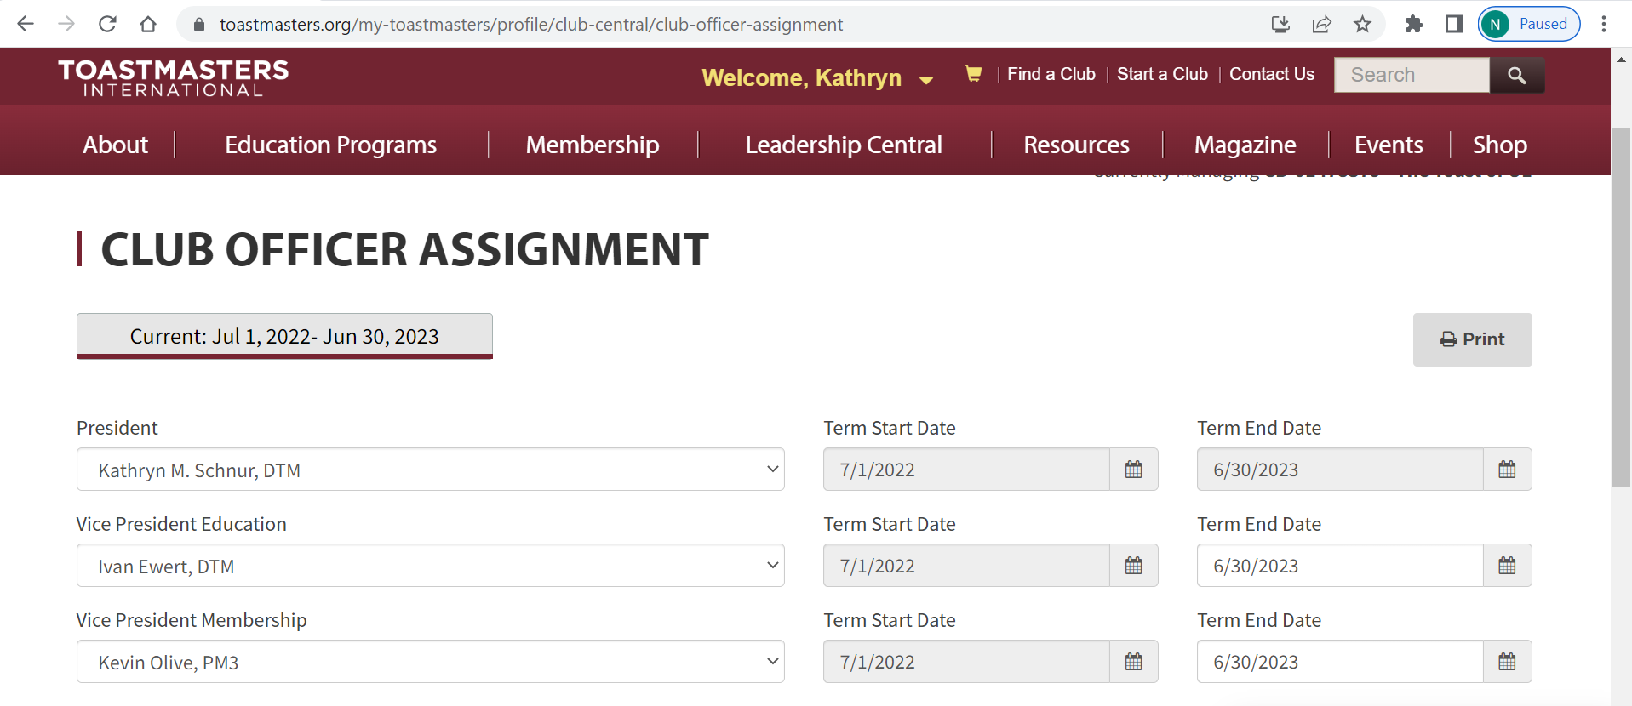

Slide 12
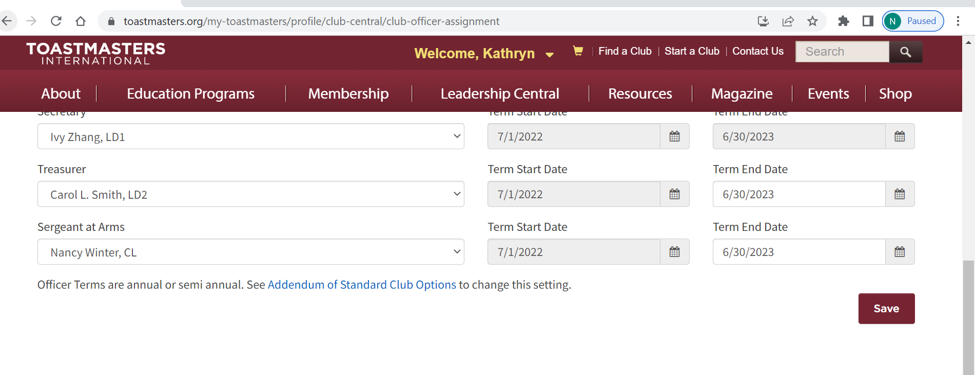

Slide 13
Responsibilities
Take the minutes at the executive committee meeting.
Maintain all club files in the cloud or on thumb drive or on paper depending on how the club handles the information. Back up the thumb drive before passing it onto the next secretary.
Handle any club correspondence.

Slide 14
Questions/Discussions
Your experiences as Secretary
Questions as a first time Secretary
Best Practices
Ideas for handling the responsibilities in a virtual/hybrid world

