Slide 1
Toastmasters Meeting Virtual Meeting Setup
General Etiquette to Provide Quality Meetings in a Virtual Setting
Notes:
Standard title page; Michele, do you want to change it up at all?

Slide 2
When Not Speaking ...
Notes:
Again, standard.

Slide 3
When Speaking ...
Mute all devices
Make your environment quiet (kids and dogs are the exceptions)
Notes:
Again, standard.

Slide 4
Our Club Mission
“We provide a supportive and positive learning experience in which members are empowered to develop communication and leadership skills, resulting in greater self-confidence and personal growth.”
Notes:
Michele, fair warning: I asked Barb to just read this rather than asking everyone to recite it like a prayer. Imean ,you know, this isn’t a church or anything like that. :)

Slide 5
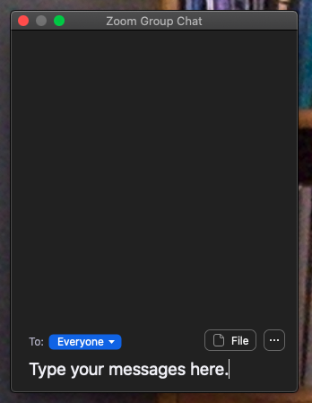
Quick Tutorial: Chat
Use chat to “Everyone” to:
Ask questions
Compliment others publicly
Use private chat to individuals to give evaluation feedback to speakers or others
Send Topicsmaster a private message to vote for best Table Topics

Slide 6
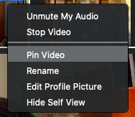
Quick Tutorial: “Pin” Our Timer
By pinning our Timer’s video panel, you will know where to look for Timer signals

Slide 7
Conventions for a Virtual Meeting
Treat this as a normal meeting and remain engaged - its easy to get distracted when meeting virtually.
Stay on mute until you speak
When done speaking, always announce who is speaking next, then mute yourself
To volunteer for TableTopics, raise your hand on video

